Slide 1


Roaa Alzanbaqi
4 May 2024

Slide 2

Outline
Executive Summary
Introduction
Methodology
Results
Conclusion

Slide 3
Executive Summary
Summary of Methodologies
Data Collection with API And Web Scraping
Data Wrangling
Exploratory Data Analysis with SQL
Exploratory Data Analysis with Data Visualization
Interactive Visual Analytics with Folium
Machine Learning Prediction
Summary of All Results
Exploratory Data Analysis
Interactive Analytics
Predictive Analytics

Slide 4
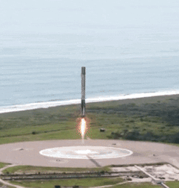
Introduction
In its quest to challenge Space X, the new rocket company, Space Y, tasked its data science team with the following objectives:
Gather information about Space X
Determine the pricing for each launch
Create dashboards to visually present key insights
Train a machine learning model to predict whether Space X will reuse the first stage

Slide 5

Section 1

Slide 6
Methodology
Executive Summary
Data collection methodology:
Data collection - SpaceX API
Data collection - Web scraping
Perform exploratory data analysis (EDA) using visualization and SQL
Perform interactive visual analytics using Folium and Plotly Dash
Perform predictive analysis using classification models

Slide 7
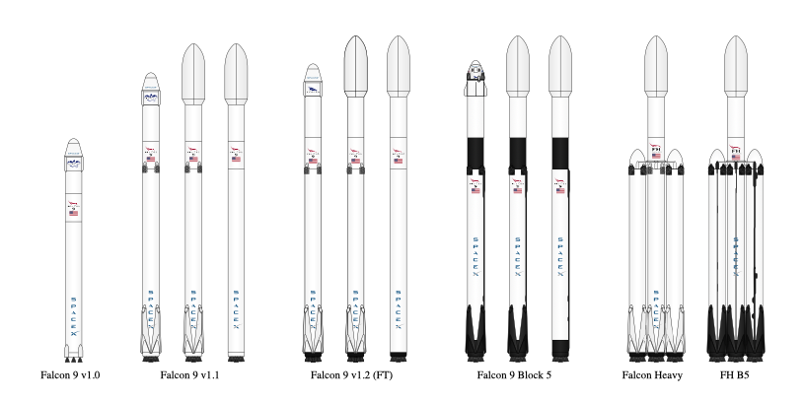
Data Collection
The data sets were collected by:
Collecting the data with an API from the SpaceX REST API, providing details about launches, including information about the rocket used, payload delivered, launch specifications, landing specifications, and landing outcome
Collecting the data with Web scraping using Beautiful Soup to extract HTML tables to get Falcon 9 launch records

Slide 8
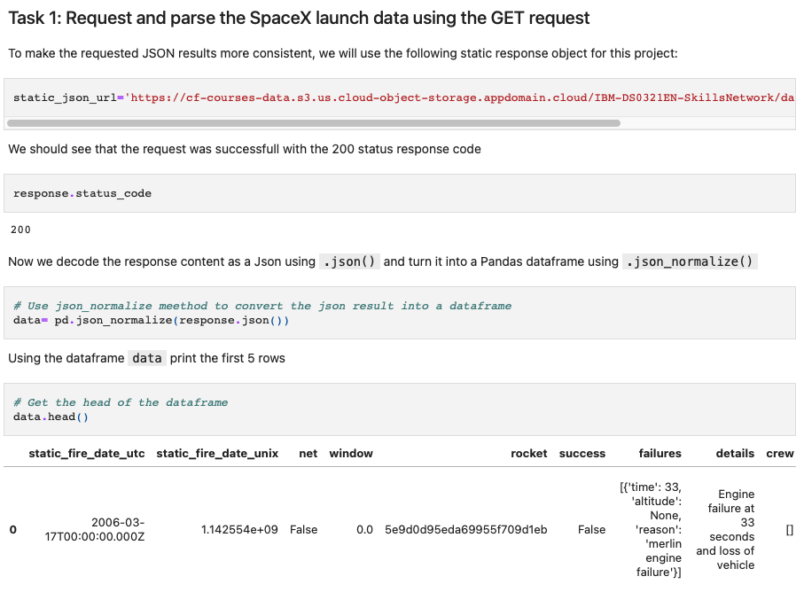
Data Collection – SpaceX API
Request and parse the SpaceX launch data using the GET request
Decode the response content as a Json and turn it into a Pandas dataframe
create a new dataframe with columns rocket, payloads, launchpad, and cores
Filter the dataframe to only include Falcon 9 launches
GitHub URL: https://github.com/Roaweeh/IBM-Data-Science-Capstone/blob/main/jupyter-labs-spacex-data-collection-api.ipynb
Place your flowchart of SpaceX API calls here

Slide 9
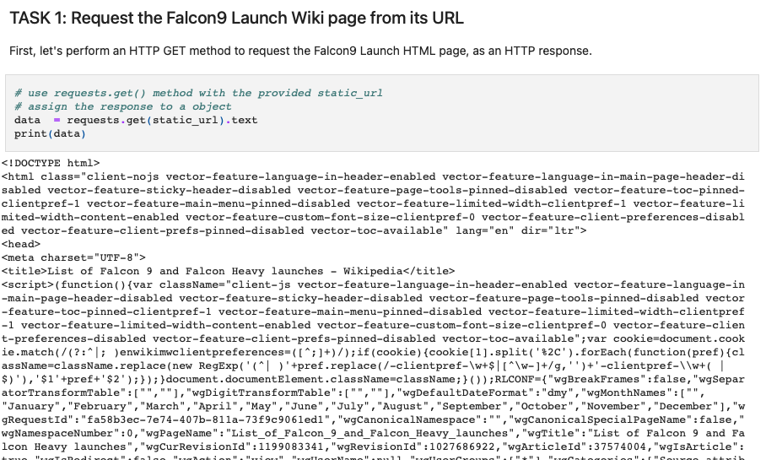
Data Collection - Scraping
Place your flowchart of web scraping here
Web scrap Falcon 9 launch records with BeautifulSoup
Extract a Falcon 9 launch records HTML table from Wikipedia
Parse the table and convert it into a Pandas data frame
GitHub URL: https://github.com/Roaweeh/IBM-Data-Science-Capstone/blob/main/jupyter-labs-webscraping.ipynb

Slide 10
Data Wrangling
The raw dataset was transformed into a clean dataset and performed some Exploratory Data Analysis (EDA) to find some patterns in the data :
Identify and calculate the percentage of the missing values
Calculate the number of launches on each site
Calculate the number and occurrence of each orbit
Calculate the number and occurrence of mission outcome of the orbits
Create a landing outcome label from Outcome column
GitHub URL: https://github.com/Roaweeh/IBM-Data-Science-Capstone/blob/main/labs-jupyter-spacex-Data%20wrangling.ipynb

Slide 11
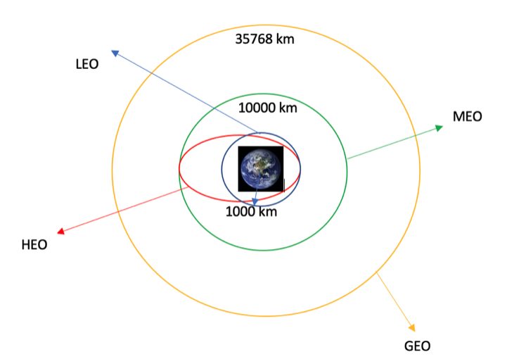
EDA with Data Visualization
Perform Exploratory Data Analysis and Feature Engineering using Pandas and Matplotlib. Charts plotted:
Flight number Vs Launch site
Payload Vs Launch site
Success rate Vs Orbit type
Flight number Vs Orbit type
Payload Vs Orbit type
The launch success yearly trend
GitHub URL: https://github.com/Roaweeh/IBM-Data-Science-Capstone/blob/main/jupyter-labs-eda-dataviz.ipynb

Slide 12
EDA with SQL
Execute the SQL queries to:
Display the names of the unique launch sites in the space mission
Display 5 records where launch sites begin with the string 'CCA'
Display the total payload mass carried by boosters launched by NASA (CRS)
Display average payload mass carried by booster version F9 v1.1
List the date when the first successful landing outcome in ground pad was achieved
List the names of the boosters which have success in drone ship and have payload mass greater than 4000 but less than 6000
List the total number of successful and failure mission outcomes
List the names of the booster versions which have carried the maximum payload mass
List the records which will display the month names, failure landing outcomes in drone ship ,booster versions, launch site for the months in year 2015
Rank the count of landing outcomes (such as Failure (drone ship) or Success (ground pad)) between the date 2010-06-04 and 2017-03-20, in descending order
GitHub URL: https://github.com/Roaweeh/IBM-Data-Science-Capstone/blob/main/jupyter-labs-eda-sql-coursera_sqllite.ipynb

Slide 13
Build an Interactive Map with Folium
Performed interactive visual analytics using Folium to:
Mark all launch sites on a map
Mark the success/failed launches for each site on the map
Calculate the distances between a launch site to its proximities
GitHub URL: https://github.com/Roaweeh/IBM-Data-Science-Capstone/blob/main/lab_jupyter_launch_site_location.jupyterlite.ipynb

Slide 14
Predictive Analysis (Classification)
Applied Machine Learning Prediction by:
Created a column for the class
Standardized the data
Split the data into training and test data
Found the best Hyperparameter for the logistic regression, support vector machine, decision tree classifier, and k-nearest neighbors methods
Found the method performs best using test data
GitHub URL: https://github.com/Roaweeh/IBM-Data-Science-Capstone/blob/main/SpaceX_Machine%20Learning%20Prediction_Part_5.ipynb

Slide 15
Results
The launch success rate has been progressively improving over the years
Factors to consider when selecting a launch site include its proximity to the Equator and its location near the coastline
The KSC LC-39A is the optimal launch site, boasting the highest success rate of approximately 80% for successful launches across payloads of various masses
The selection of the most suitable orbit depends on the payload mass. For payloads weighing over 8000 kg, it is recommended to consider the ISS, PO, and VLEO orbits. Conversely, for payloads under 8000 kg, it is advisable to use the LEO, GTO, and SSO orbits
The four machine learning models exhibited similar performance

Slide 16

Section 2

Slide 17
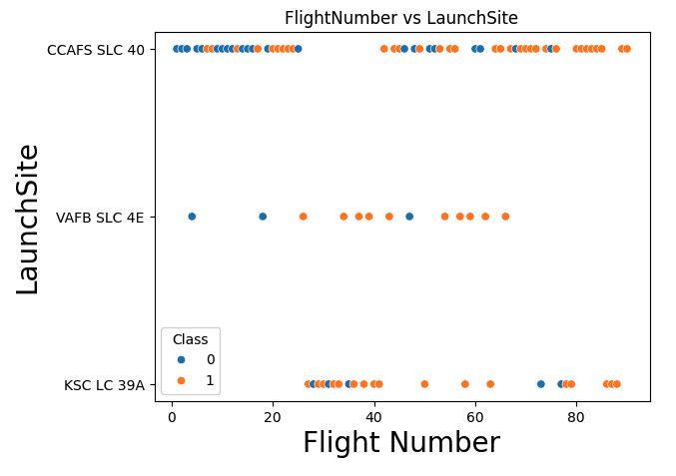
Flight Number vs. Launch Site
The scatter plot shows the relation between the flight number and the launch site
Based on the scatter plot, there does not appear to be a clear correlation between the launch site and the number of flights that have occurred

Slide 18
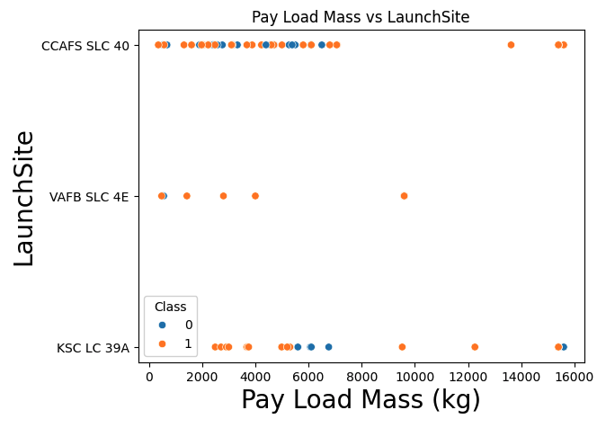
Payload vs. Launch Site
The scatter plot shows the relation between the payload mass and the different launch sites
At the VAFB-SLC launch site, there have been no launches of rockets carrying payloads exceeding 10,000 kg
At the CCAFS-SLC launch site, there have been no launches of rockets carrying payloads between 8,000 and 13,000 kg
Among the three launch sites, KSC-LC was the one that conducted launches with payloads of different masses

Slide 19
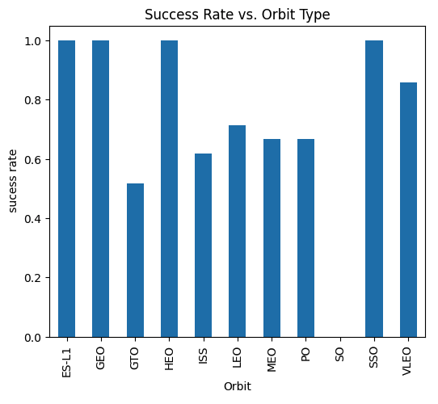
Success Rate vs. Orbit Type
The bar chart shows the relation between success rate and the orbit type
Based on the data shown in the figure, it can be inferred that the orbits ES-L1, GEO, HEO, and SSO exhibit the highest success rates among all orbit types with 100% success rate
Other orbits have a success rates between 50% up to 80%
Among all orbit types, the SO orbit achieved a 0% success rate, representing the lowest success rate

Slide 20
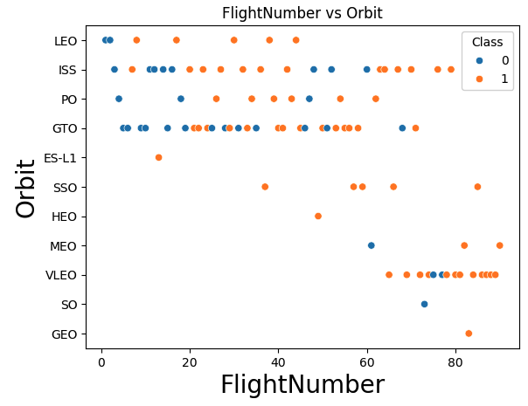
Flight Number vs. Orbit Type
The scatter plot shows the relation between flight number and the orbit type
Comparing the scatter plot of Flight Number vs Orbit Type with the Success Rate vs Orbit Type bar plot, we conclude that the reported 100% success rate for orbits ES-L1, GEO, and HEO is based on misleading data from a single flight occurrence and should not be considered valid
Similarly, the SO orbit achieved a 0% success rate due to a single failed flight occurrence
For a more reliable analysis, it is advisable to exclude any orbit with fewer than 5 total flight numbers

Slide 21
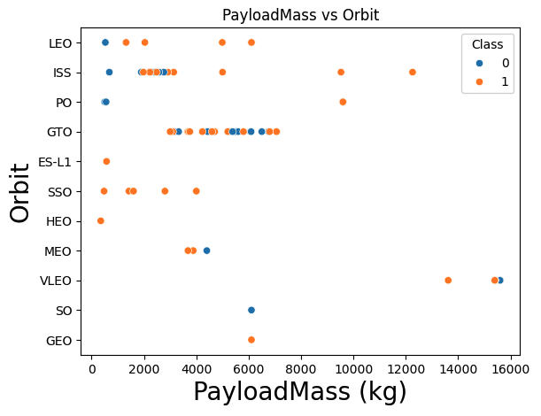
Payload vs. Orbit Type
The scatter plot shows the relation between flight number and the orbit type
For payloads over 8000 kg, consider using the ISS, PO and VLEO orbits for their proven success
For payloads under 8000 kg, consider using the LEO, GTO and SSO orbits for their higher success rates compared to other orbits

Slide 22
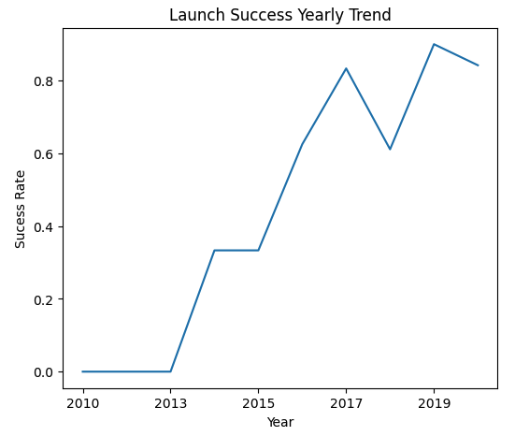
Launch Success Yearly Trend
The line chart shows the relation between launch success and the yearly trend
The chart shows that the overall success rate of launches has consistently increased from 2013 to 2020

Slide 23
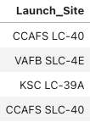
All Launch Site Names
Find the names of the unique launch sites:
Query:
There are four launch sites, they are:
CCAFC-LC-40
VAFB-SLC-4E
KSC-LC-39A
CCAFS-SLC-40
Result:

Slide 24
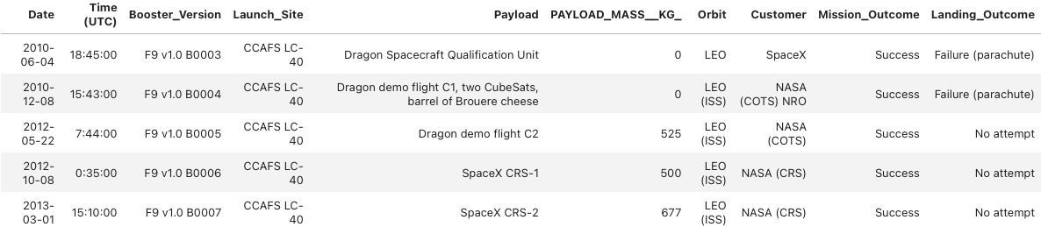
Launch Site Names Begin with 'CCA'
Find 5 records where launch sites begin with `CCA`:
Query:
The table shows five launch sites names that begin with `CCA`
Results:

Slide 25
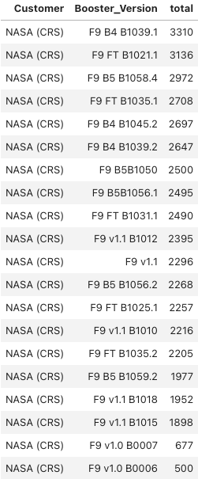
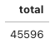
Total Payload Mass
Calculate the total payload carried by boosters from NASA (CRS):
Query:
The table displays the total payload masses in kilograms for each NASA (CRS) booster, with the booster version F9 B4 B1039.1 achieving the highest total payload mass of 3,310 kg
The combined total payload mass for all boosters is 45,596 kg
Result:

Slide 26
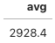
Average Payload Mass by F9 v1.1
Calculate the average payload mass carried by booster version F9 v1.1:
Query:
The average payload mass carried by booster version F9 v1.1 is about 2928.4 kg
Result:

Slide 27
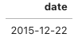
First Successful Ground Landing Date
Find the dates of the first successful landing outcome on ground pad:
Query:
The first successful landing on a ground pad was achieved on December 22, 2015
Result:

Slide 28
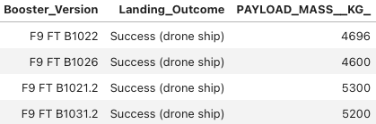
Successful Drone Ship Landing with Payload between 4000 and 6000
List the names of boosters which have successfully landed on drone ship and had payload mass greater than 4000 but less than 6000:
Query:
The boosters that have successfully landed on a drone ship with a payload mass greater than 4,000 kg but less than 6,000 kg are:
F9 FT B1022
F9 FT B1026
F9 FT B1021.2
F9 FT B1031.2
Result:

Slide 29
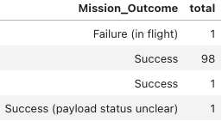
Total Number of Successful and Failure Mission Outcomes
Calculate the total number of successful and failure mission outcomes:
Query:
Result:
There have been a total of 100 successful missions, with only one mission that ended in failure

Slide 30
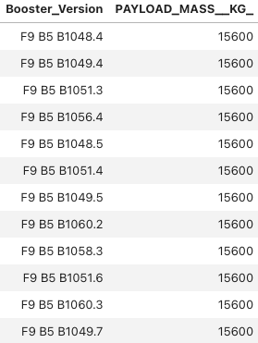
Boosters Carried Maximum Payload
List the names of the booster which have carried the maximum payload mass:
Query:
The table shows the names of boosters that have carried a maximum payload mass of approximately 15,600 kg
Result:

Slide 31
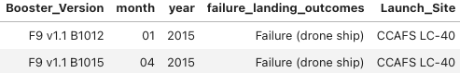
2015 Launch Records
List the failed landing outcomes in drone ship, their booster versions, and launch site names for in year 2015:
Query:
There were two unsuccessful landing attempts on a drone ship that occurred in 2015
Result:

Slide 32
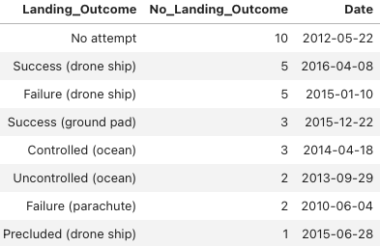
Rank Landing Outcomes Between 2010-06-04 and 2017-03-20
Rank the count of landing outcomes (such as Failure (drone ship) or Success (ground pad)) between the date 2010-06-04 and 2017-03-20, in descending order:
Query:
Result:

Slide 33

Section 3

Slide 34
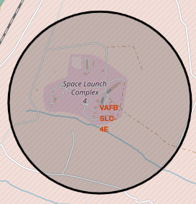
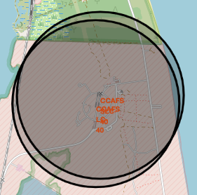
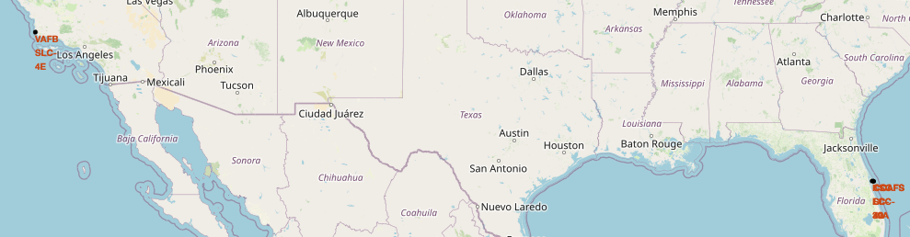
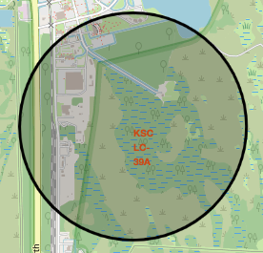
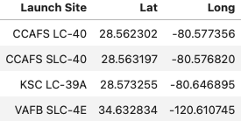
All Launch Sites
Based on the map screenshot, it's evident that the four launch sites are:
Located near the Equator
Positioned close to the coastline

Slide 35
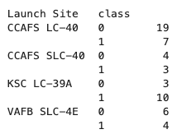
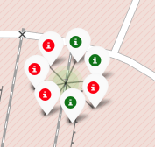
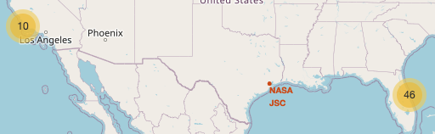
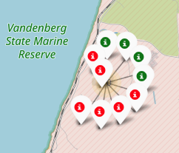
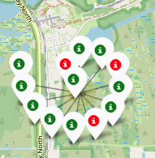
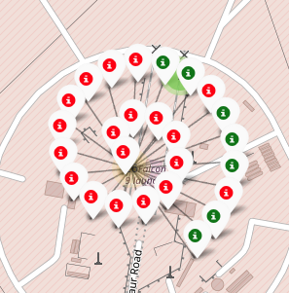
Success and Failed Launches for Each Site
CCAFS SLC-40
CCAFS LC-40
VAFB SLC-4E
KSC LC-39A
The launch site KSC LC-39A maintains the highest success rate, estimated at approximately 80% for successful launches, while other launch sites have success rates of roughly less than 50%

Slide 36
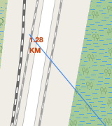
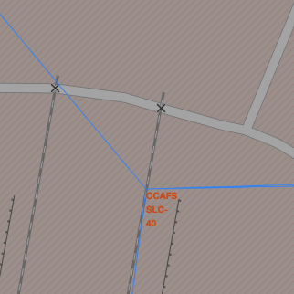
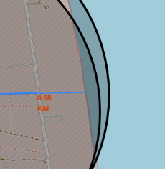
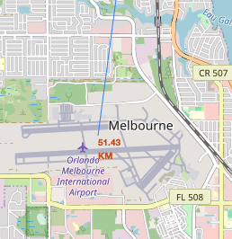
The Distance Between a Launch Site to its Proximities
All launch sites are situated at a distance from nearby cities but are conveniently located near highways, railways, and airport
The launch site KSC LC-39A is located slightly farther away from the coast compared to the other launch sites

Slide 37

Section 5

Slide 38
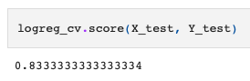
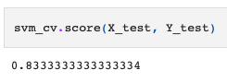
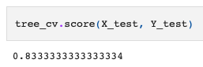
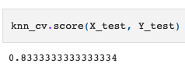
Classification Accuracy
The accuracy for all built classification models:
Logistic Regression:
Support Vector Machine:
Decision Tree Classifier:
K-Nearest Neighbors
The logistic regression, support vector machine, decision tree classifier, and k-nearest neighbors models all produce similar accuracy results

Slide 39
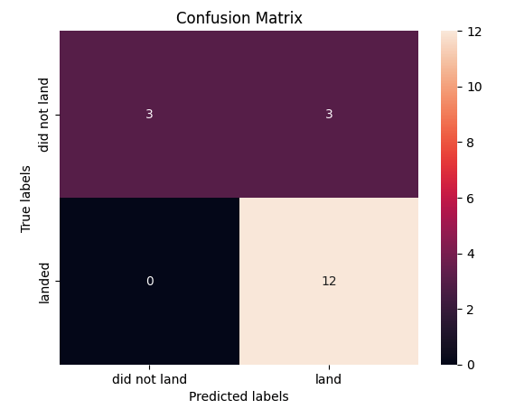
Confusion Matrix
The confusion matrix provides a summary of a classification algorithm's performance
The confusion matrices for logistic regression, support vector machine, decision tree classifier, and k-nearest neighbors models were all identical having:
12 True Positive
3 True Negative
3 False Positive
0 False Negative

Slide 40
Conclusions
The launch success rate has been progressively improving over the years
Factors to consider when selecting a launch site include its proximity to the Equator and its location near the coastline
The KSC LC-39A is the optimal launch site, boasting the highest success rate of approximately 80% for successful launches across payloads of various masses
The selection of the most suitable orbit depends on the payload mass. For payloads weighing over 8000 kg, it is recommended to consider the ISS, PO, and VLEO orbits. Conversely, for payloads under 8000 kg, it is advisable to use the LEO, GTO, and SSO orbits
The four machine learning models exhibited similar performance

Slide 41


